Slide 1

Unsupervised Machine Learning for Clustering Mental Health Posts
An Insight into the Mental Health of Cancer Patients
Author: Caleb White
Date: March 3, 2024

Slide 2
Introduction
Problem: Cancer patients face unique mental health challenges that are often discussed in online forums and support groups. Analyzing these discussions can provide insights into their concerns and needs.
Goal: Utilize unsupervised machine learning, specifically text clustering algorithms, to group mental health-related posts from cancer patients into well-defined clusters.

Slide 3
Problem Definition
Unstructured Data: The primary challenge lies in the nature of the data – vast amounts of unstructured text from online posts. These texts came with pre-labeled sentiments and categories, which were removed for the text clustering analysis portion.
Significance: Identifying natural groupings within the data can reveal specific mental health challenges and experiences unique to cancer patients.

Slide 4
Data Source
Source: The dataset is sourced from Kaggle, compiled from various online platforms including Reddit, Daily Strength, and Health Board.
Composition: It contains over 10,087 posts focusing on five types of cancer: brain, colon, liver, leukemia, and lung cancer.
Emotional Scoring System: Each post was scored by based on the emotions expressed, using a scale from -2 to 1, with 0 indicating neutral emotions.

Slide 5

Data Cleaning and Preparation
Cleaning Steps:
URLs and special characters were removed to clean the text.
Text was tokenized into individual words.
Stop words were removed, and words were lemmatized to their base form.
Importance: These preprocessing steps are essential to reduce noise in the data and ensure the machine learning models can identify meaningful patterns and relationships.

Slide 6
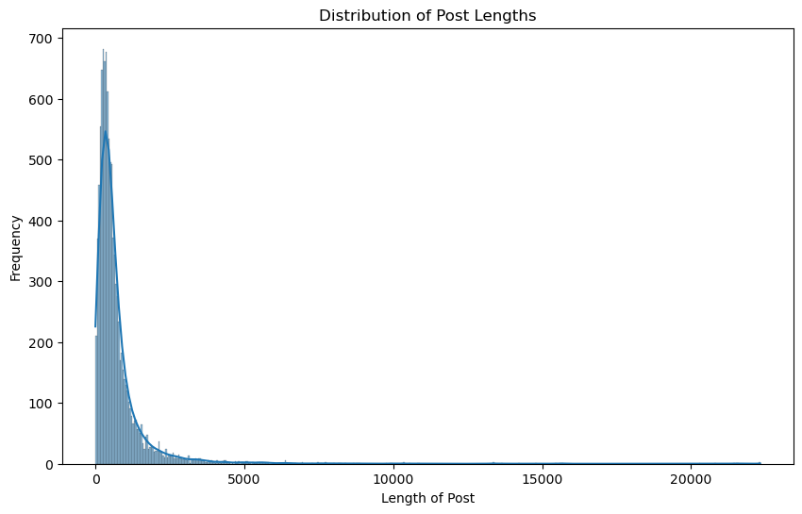
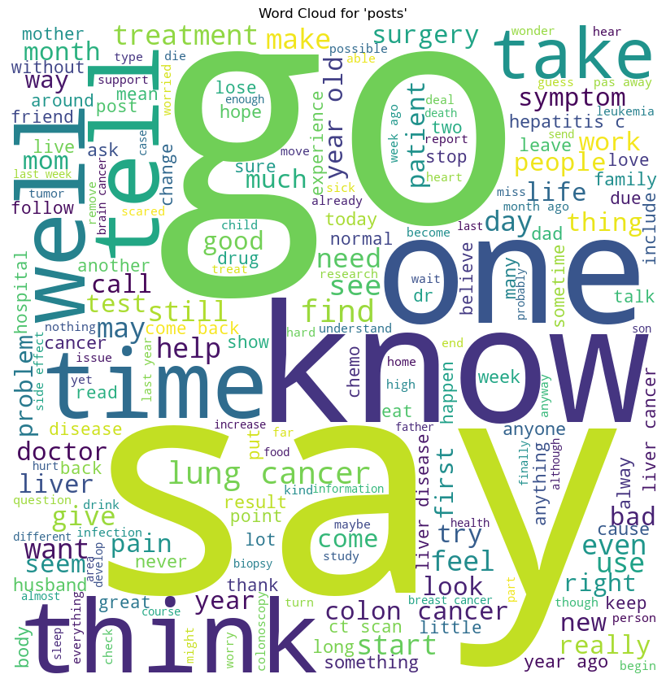
EDA
Word Cloud Visualization: The word cloud highlighted the most frequent terms.
Post Length Distribution: Analysis showed most posts are brief.
Findings: The EDA revealed prevalent themes and the predominance of short posts.

Slide 7
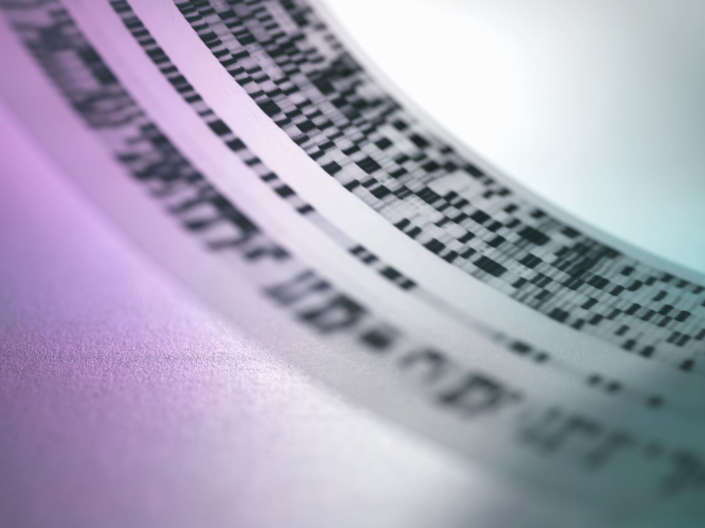
Modeling and Clustering
TF-IDF Vectorization: Transformed the text data into a numerical format, emphasizing important words while filtering out common language.
K-Means Clustering: Applied to group posts based on textual similarity. The optimal number of clusters was determined through iterative testing, focusing on achieving meaningful group distinctions

Slide 8
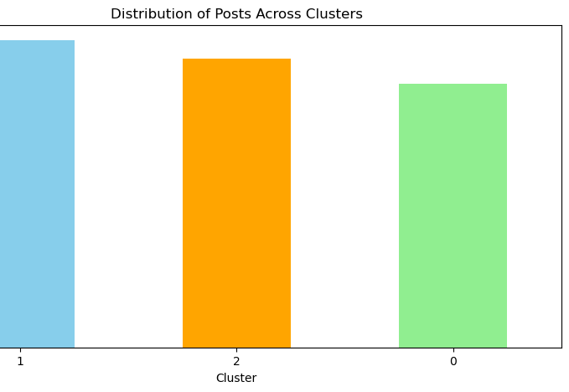
Results and Interpretation
Clustering Results: Posts were successfully grouped into clusters reflecting varying sentiments and topics.
Insights Gained: The clustering revealed patterns and themes not immediately apparent.

Slide 9
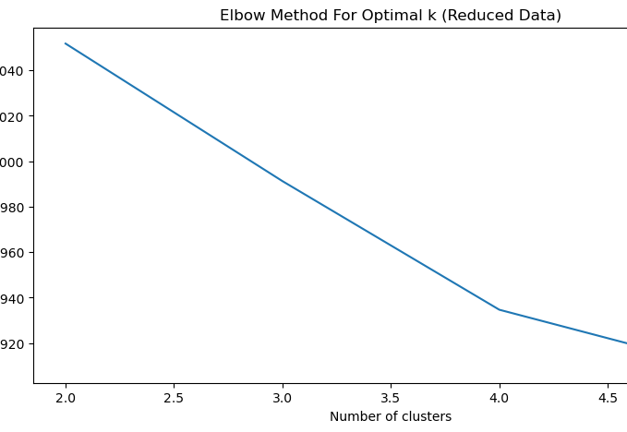
Iterative & Technique Improvement
Dimensionality Reduction: Applied Truncated SVD to reduce the feature space while preserving essential information.
Further Improvements: Proposed the use of advanced NLP techniques such as word embeddings and alternative clustering algorithms to refine and deepen the analysis.

Slide 10

Conclusion and Future Directions
Key Takeaways: The project demonstrated the potential of unsupervised learning to uncover hidden patterns in unstructured text data, offering valuable insights into cancer patients’ mental health concerns.
Future Directions: Suggested integrating semi-supervised learning for more precise sentiment analysis and leverage both labeled and unlabeled data for enhanced understanding and support for mental health issues.

